Slide 1
Chapter 15 Event-Driven Programming and Animations

Slide 2
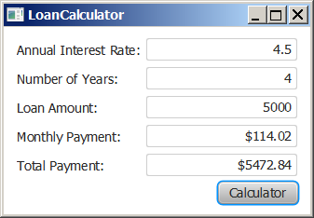
Motivations
Suppose you want to write a GUI program that lets the user enter a loan amount, annual interest rate, and number of years and click the Compute Payment button to obtain the monthly payment and total payment. How do you accomplish the task? You have to use event-driven programming to write the code to respond to the button-clicking event.
LoanCalculator
Run

Slide 3
Objectives
To get a taste of event-driven programming (§15.1).
To describe events, event sources, and event classes (§15.2).
To define handler classes, register handler objects with the source object, and write the code to handle events (§15.3).
To define handler classes using inner classes (§15.4).
To define handler classes using anonymous inner classes (§15.5).
To simplify event handling using lambda expressions (§15.6).
To develop a GUI application for a loan calculator (§15.7).
To write programs to deal with MouseEvents (§15.8).
To write programs to deal with KeyEvents (§15.9).
To create listeners for processing a value change in an observable object (§15.10).
To use the Animation, PathTransition, FadeTransition, and Timeline classes to develop animations (§15.11).
To develop an animation for simulating a bouncing ball (§15.12).

Slide 4
Event-Driven Programming
In computer programming, event-driven programming is a programming paradigm in which the flow of the program is determined by events such as user actions (mouse clicks, key presses), sensor outputs, or messages from other programs/threads.

Slide 5
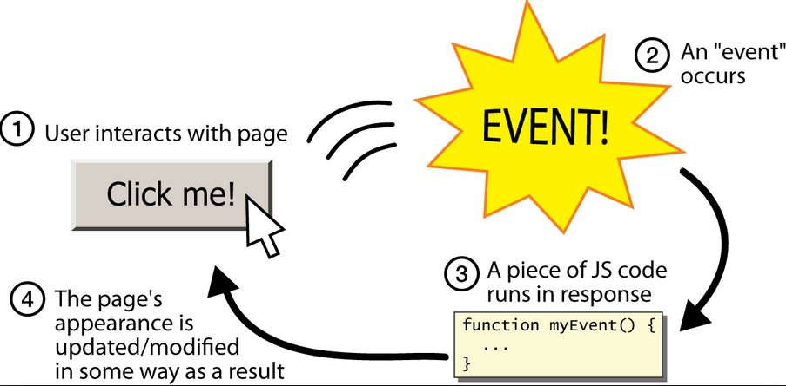
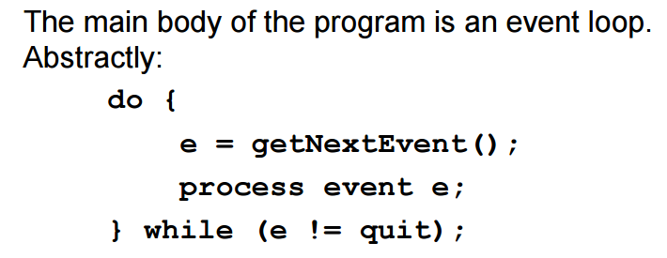
Web Event

Slide 6
Even-Driven Programming
Most programs and devices like a cellphone respond to events — things that happen. For example, you might move your mouse, and the computer responds. Or you click a button, and the program does something interesting.
In this chapter we’ll touch very briefly on how event-driven programming works.

Slide 7
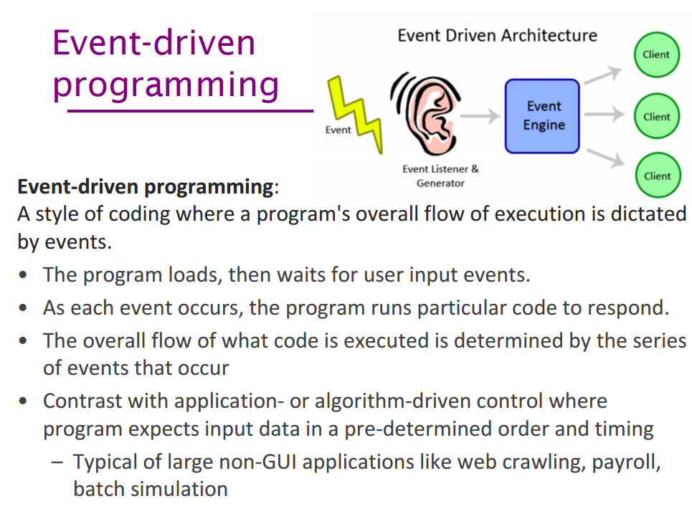

Slide 8
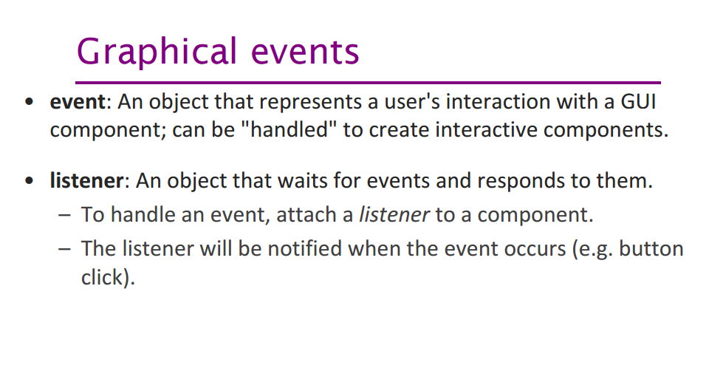

Slide 9
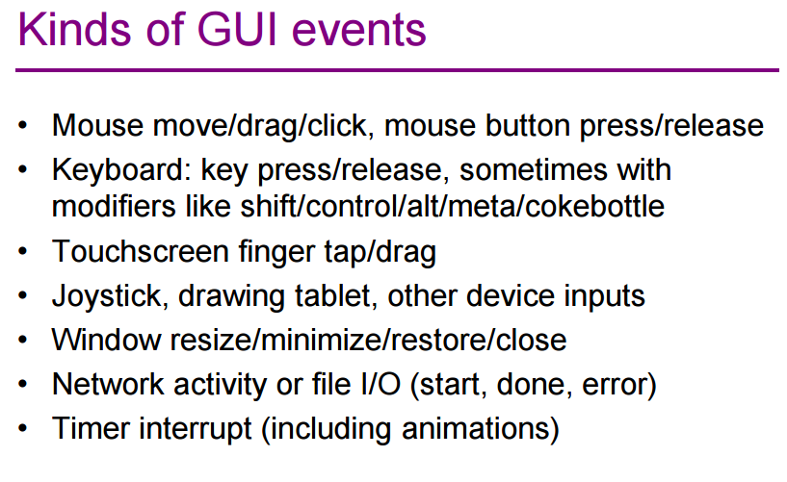

Slide 10
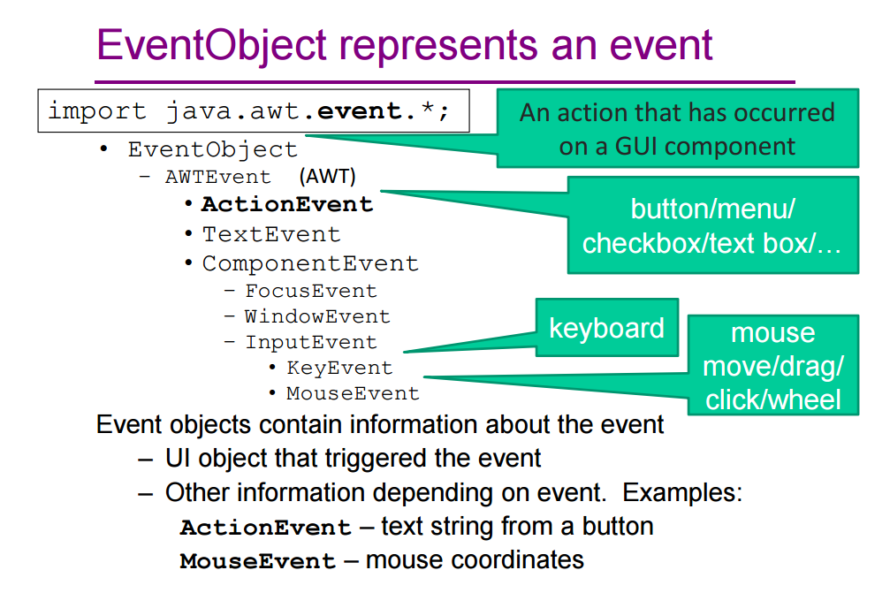

Slide 11
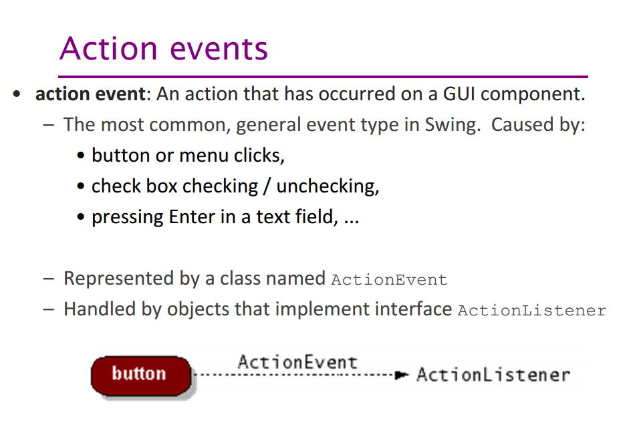

Slide 12
Procedural vs. Event-Driven Programming
Procedural programming is executed in procedural order.
In event-driven programming, code is executed upon activation of events.

Slide 13
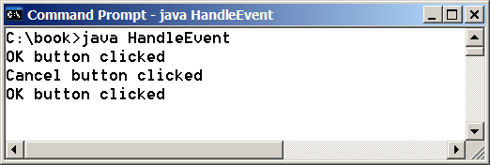
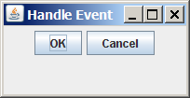
Taste of Event-Driven Programming
The example displays a button in the frame. A message is displayed on the console when a button is clicked.
HandleEvent
Run

Slide 14
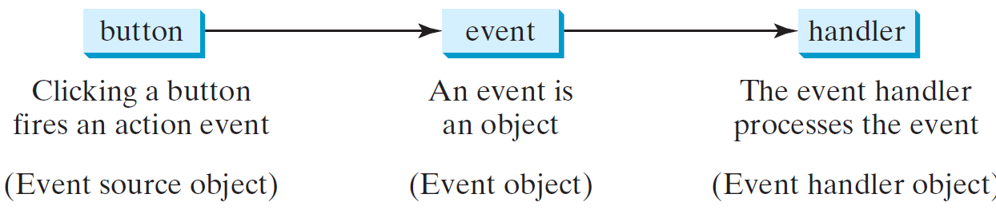
Handling GUI Events
Source object (e.g., button)
Listener object contains a method for processing the event.
14

Slide 15
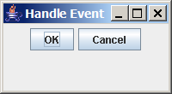
Trace Execution
animation
public class HandleEvent extends Application {
public void start(Stage primaryStage) {
…
OKHandlerClass handler1 = new OKHandlerClass();
btOK.setOnAction(handler1);
CancelHandlerClass handler2 = new CancelHandlerClass();
btCancel.setOnAction(handler2);
…
primaryStage.show(); // Display the stage
}
}
class OKHandlerClass implements EventHandler<ActionEvent> {
@Override
public void handle(ActionEvent e) {
System.out.println("OK button clicked");
}
}
1. Start from the main method to create a window and display it
15

Slide 16
Trace Execution
animation
public class HandleEvent extends Application {
public void start(Stage primaryStage) {
…
OKHandlerClass handler1 = new OKHandlerClass();
btOK.setOnAction(handler1);
CancelHandlerClass handler2 = new CancelHandlerClass();
btCancel.setOnAction(handler2);
…
primaryStage.show(); // Display the stage
}
}
class OKHandlerClass implements EventHandler<ActionEvent> {
@Override
public void handle(ActionEvent e) {
System.out.println("OK button clicked");
}
}
2. Click OK
16

Slide 17
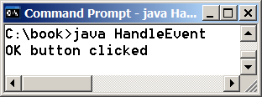
Trace Execution
animation
public class HandleEvent extends Application {
public void start(Stage primaryStage) {
…
OKHandlerClass handler1 = new OKHandlerClass();
btOK.setOnAction(handler1);
CancelHandlerClass handler2 = new CancelHandlerClass();
btCancel.setOnAction(handler2);
…
primaryStage.show(); // Display the stage
}
}
class OKHandlerClass implements EventHandler<ActionEvent> {
@Override
public void handle(ActionEvent e) {
System.out.println("OK button clicked");
}
}
3. Click OK. The JVM invokes the listener’s handle method
17

Slide 18
Events
An event can be defined as a type of signal to the program that something has happened.
The event is generated by external user actions such as mouse movements, mouse clicks, or keystrokes.

Slide 19
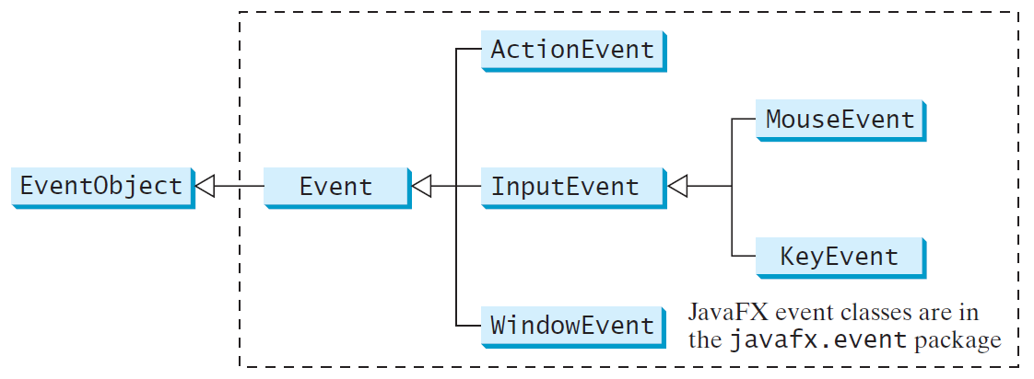
Event Classes

Slide 20
Event Information
An event object contains whatever properties are pertinent to the event. You can identify the source object of the event using the getSource() instance method in the EventObject class. The subclasses of EventObject deal with special types of events, such as button actions, window events, component events, mouse movements, and keystrokes. Table 16.1 lists external user actions, source objects, and event types generated.

Slide 21
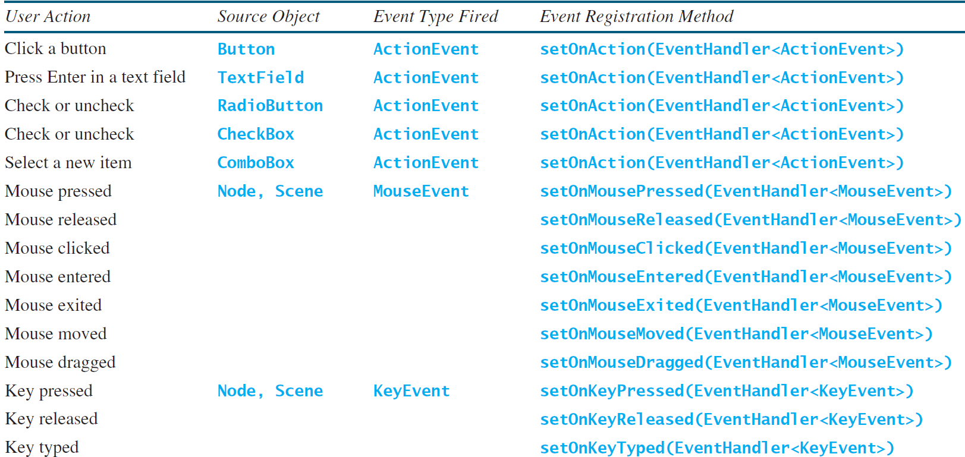
Selected User Actions and Handlers

Slide 22
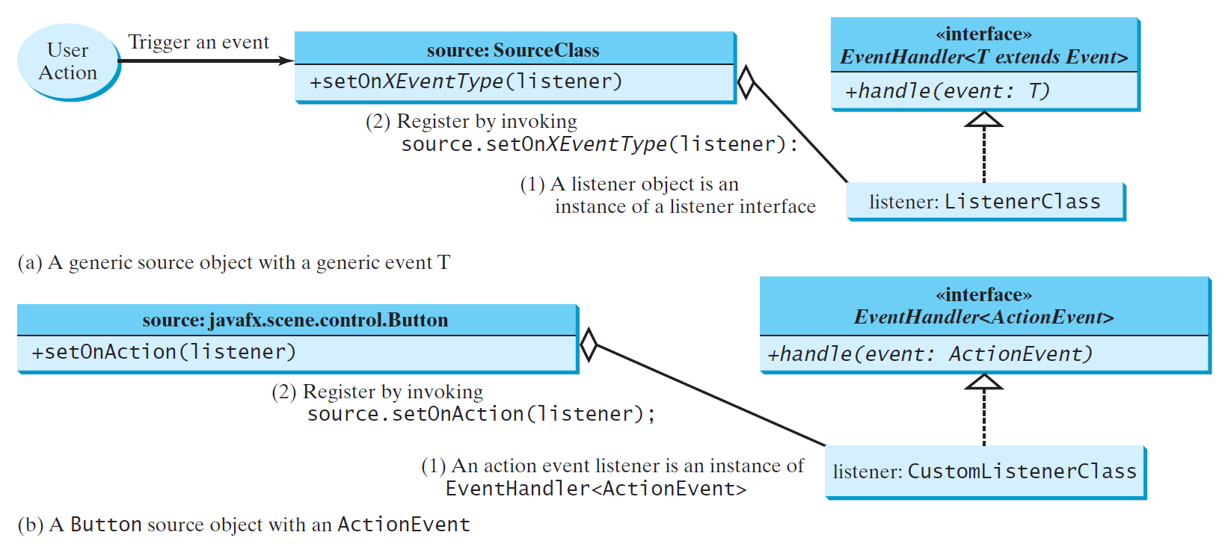
The Delegation Model

Slide 23
The Delegation Model: Example
Button btOK = new Button("OK");
OKHandlerClass handler = new OKHandlerClass();
btOK.setOnAction(handler);

Slide 24
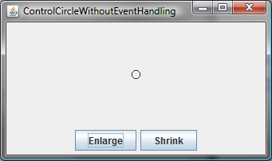
Example: First Version for ControlCircle (no listeners)
Now let us consider to write a program that uses two buttons to control the size of a circle.
ControlCircleWithoutEventHandling
Run

Slide 25
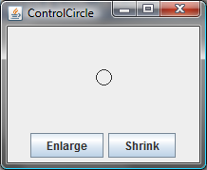
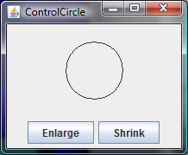
Example: Second Version for ControlCircle (with listener for Enlarge)
Now let us consider to write a program that uses two buttons to control the size of a circle.
ControlCircle
Run

Slide 26
Inner Class Listeners
A listener class is designed specifically to create a listener object for a GUI component (e.g., a button). It will not be shared by other applications. So, it is appropriate to define the listener class inside the frame class as an inner class.

Slide 27
Inner Classes
Inner class: A class is a member of another class.
Advantages: In some applications, you can use an inner class to make programs simple.
An inner class can reference the data and methods defined in the outer class in which it nests, so you do not need to pass the reference of the outer class to the constructor of the inner class.
ShowInnerClass

Slide 28
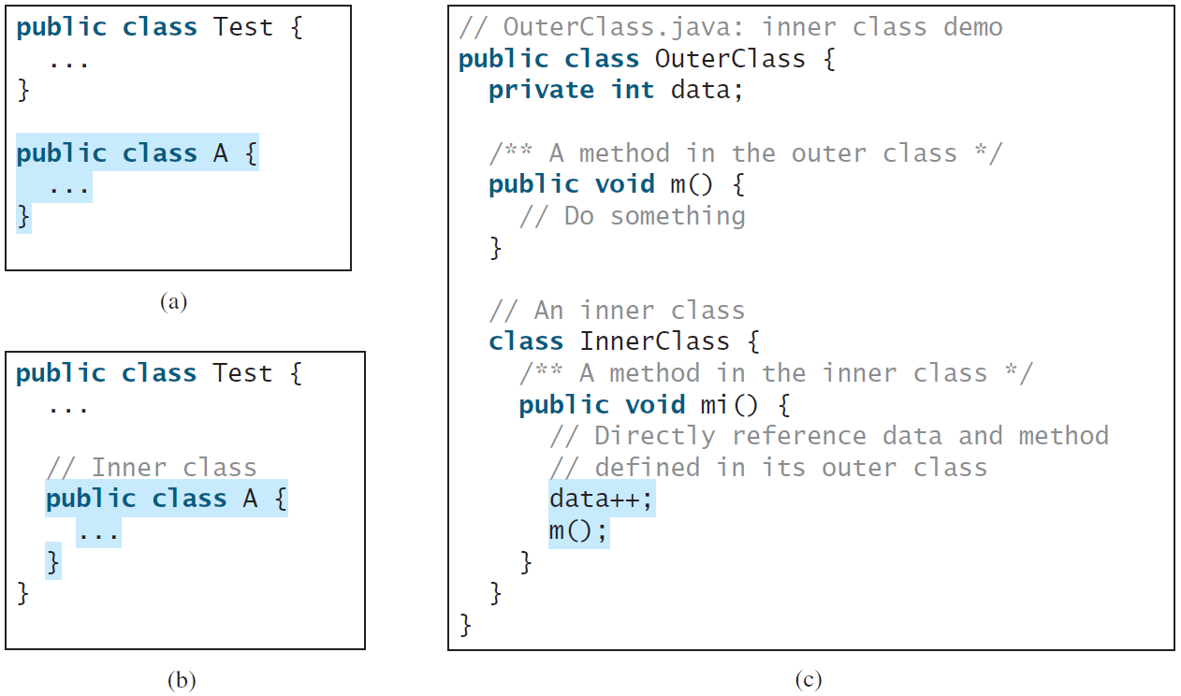
Inner Classes, cont.

Slide 29
Inner Classes (cont.)
Inner classes can make programs simple and concise.
An inner class supports the work of its containing outer class and is compiled into a class named OuterClassName$InnerClassName.class. For example, the inner class InnerClass in OuterClass is compiled into OuterClass$InnerClass.class.

Slide 30
Inner Classes (cont.)
An inner class can be declared public, protected, or private subject to the same visibility rules applied to a member of the class.
An inner class can be declared static. A static inner class can be accessed using the outer class name. A static inner class cannot access nonstatic members of the outer class

Slide 31
Anonymous Inner Classes
An anonymous inner class must always extend a superclass or implement an interface, but it cannot have an explicit extends or implements clause.
An anonymous inner class must implement all the abstract methods in the superclass or in the interface.
An anonymous inner class always uses the no-arg constructor from its superclass to create an instance. If an anonymous inner class implements an interface, the constructor is Object().
An anonymous inner class is compiled into a class named OuterClassName$n.class. For example, if the outer class Test has two anonymous inner classes, these two classes are compiled into Test$1.class and Test$2.class.

Slide 32
Anonymous Inner Classes (cont.)
Inner class listeners can be shortened using anonymous inner classes. An anonymous inner class is an inner class without a name. It combines declaring an inner class and creating an instance of the class in one step. An anonymous inner class is declared as follows:
new SuperClassName/InterfaceName() {
// Implement or override methods in superclass or interface
// Other methods if necessary
}

Slide 33
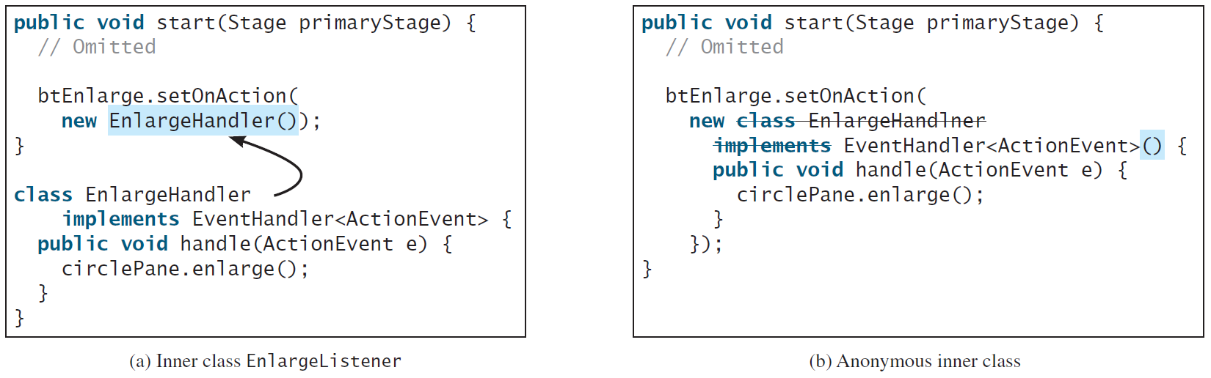
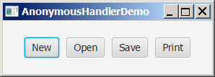
Anonymous Inner Classes (cont.)
AnonymousHandlerDemo
Run

Slide 34
Simplifying Event Handing Using Lambda Expressions
Lambda expression is a new feature in Java 8. Lambda expressions can be viewed as an anonymous method with a concise syntax. For example, the following code in (a) can be greatly simplified using a lambda expression in (b) in three lines.

Slide 35
Basic Syntax for a Lambda Expression
The basic syntax for a lambda expression is either
(type1 param1, type2 param2, ...) -> expression
or
(type1 param1, type2 param2, ...) -> { statements; }
The data type for a parameter may be explicitly declared or implicitly inferred by the compiler. The parentheses can be omitted if there is only one parameter without an explicit data type.

Slide 36
Single Abstract Method Interface (SAM)
The statements in the lambda expression is all for that method. If it contains multiple methods, the compiler will not be able to compile the lambda expression. So, for the compiler to understand lambda expressions, the interface must contain exactly one abstract method. Such an interface is known as a functional interface, or a Single Abstract Method (SAM) interface.
AnonymousHandlerDemo
Run

Slide 37
Problem: Loan Calculator
LoanCalculator
Run

Slide 38
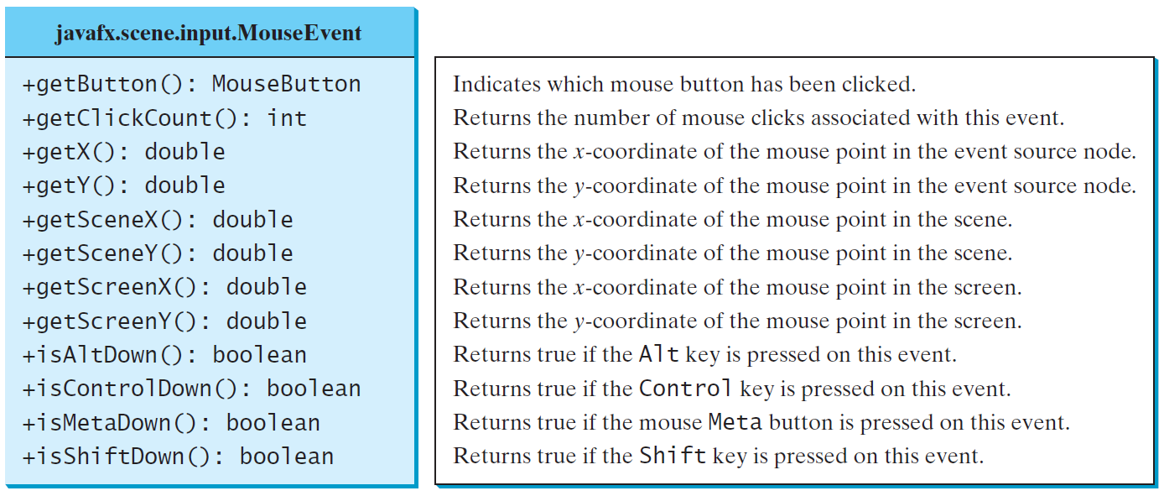
MouseEvent
MouseEventDemo
Run

Slide 39
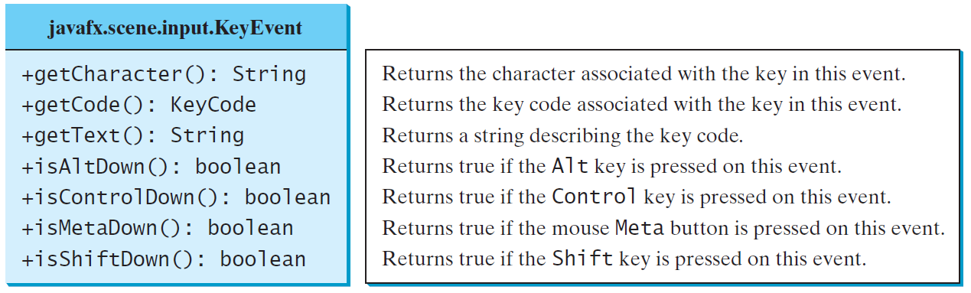
The KeyEvent Class
MouseEventDemo
Run

Slide 40
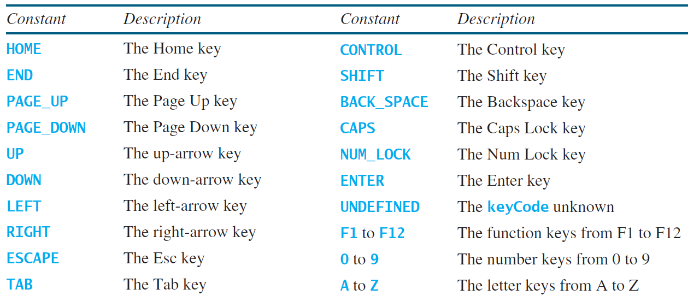
The KeyCode Constants

Slide 41
Example: Control Circle with Mouse and Key
ControlCircleWithMouseAndKey
Run

Slide 42
Listeners for Observable Objects
You can add a listener to process a value change in an observable object.
An instance of Observable is known as an observable object, which contains the addListener(InvalidationListener listener) method for adding a listener. Once the value is changed in the property, a listener is notified. The listener class should implement the InvalidationListener interface, which uses the invalidated(Observable o) method to handle the property value change. Every binding property is an instance of Observable.
ObservablePropertyDemo
Run
DisplayResizableClock
Run

Slide 43
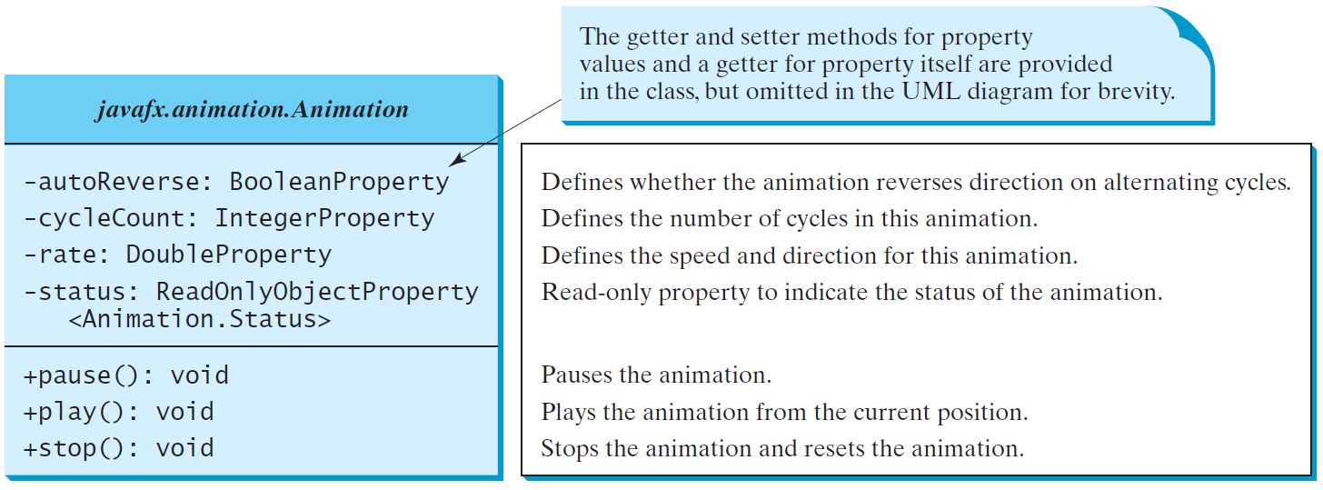
Animation
JavaFX provides the Animation class with the core functionality for all animations.

Slide 44
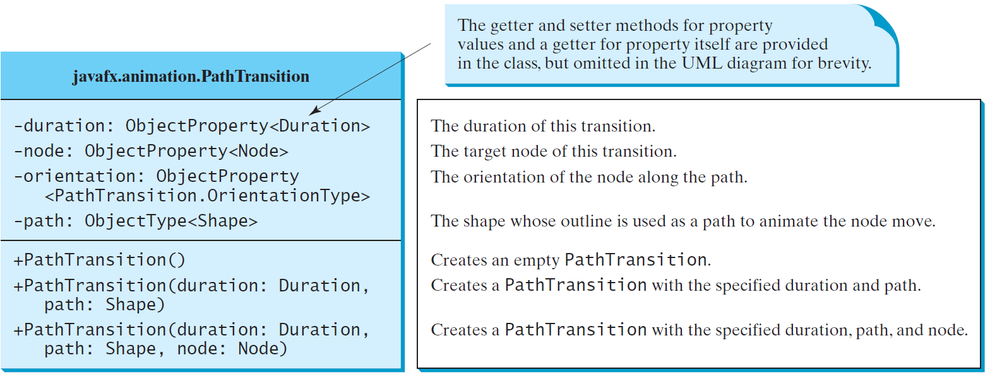
PathTransition
PathTransitionDemo
Run
FlagRisingAnimation
Run

Slide 45
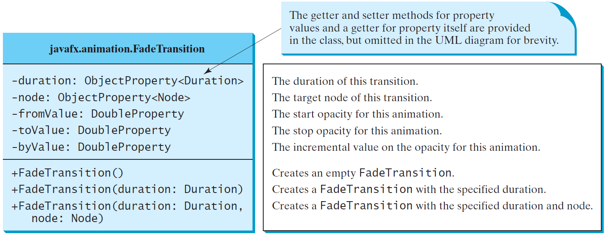
FadeTransition
The FadeTransition class animates the change of the opacity in a node over a given time.
FadeTransitionDemo
Run

Slide 46
Timeline
PathTransition and FadeTransition define specialized animations. The Timeline class can be used to program any animation using one or more KeyFrames. Each KeyFrame is executed sequentially at a specified time interval. Timeline inherits from Animation.
TimelineDemo
Run

Slide 47
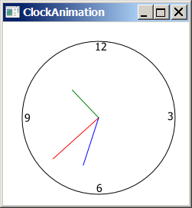
Clock Animation
ClockAnimation
Run

Slide 48
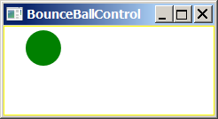
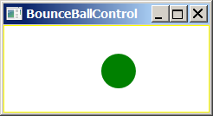
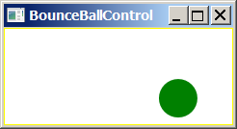
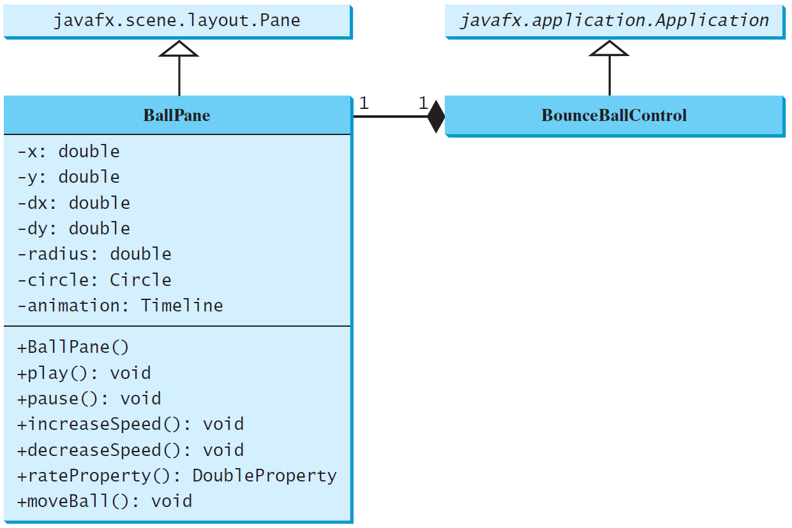
Case Study: Bouncing Ball
BallPane
BounceBallControl
Run

